Slide 1
Health Partners of California: Provider Map Search
Quick Search Tips
https://healthpartnersnca.org/provider-search/

Slide 2
The HPNC searchable directory will load with all 5,900+ providers. Each location will show visually with a Marker on the map. The first time the directory loads on any device, it will take about 30 seconds for it to pull all the providers in for you to search. After the initial load, all refreshes will run much quicker.
The buttons in the upper left of the map allow you to zoom. You can also use CTRL + Scroll on your keyboard or pinch on your mobile devices.
On your desktop, the button in the upper right of the map allows you to use a full-sized map. When in full size, the Esc button will return you to the smaller size.
There are several ways to search/filter for providers. The default search is set to Modesto, CA. You don’t need to do any search to get started. The search bar has 2 sections:
The Enter a Location will do a proximity search based on either the zip code or the city, or the use my location you enter.
Click the magnifying glass to initiate the search.
This sorts the Provider Detail table results from nearest to furthest. *This does not filter results.
The right side of the search bar is for specific results. For example, searching for ‘Valley’ will return any groups, providers, or street addresses with the word ‘Valley.’

Slide 3
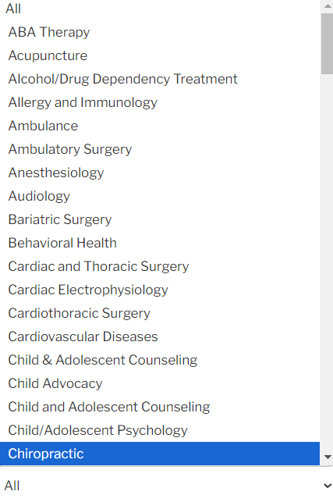
The HPNC searchable directory will load with all 5,900+ providers. The provider details will show in the table below the map.
The Show (25) Entries controls how many of the providers you see in the table per page. Using the drop-down arrow allows you to adjust the number shown.
The Provider Detail table provides the following details:
Group Name
Practitioner Name
Specialty
Location,
Phone
Accepting new patients?
The number of fields visible on your screen will adjust depending on the width available on your device and will collapse with a + sign for the additional fields that don’t fit your screen.
On mobile devices, you can call the phone number by first selecting the phone number. This will provide the option to call number.
You can sort by each field using the Arrows next to the field name.
The Filter By defaults to All, but using the arrow allows you to filter the providers by specialty.

Slide 4
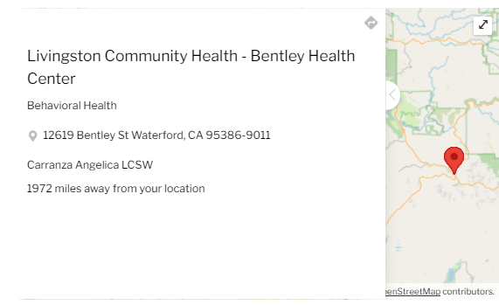
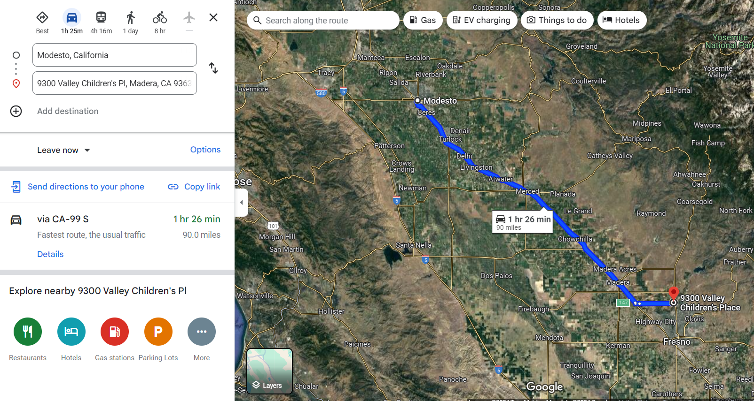
The HPNC searchable directory will load with all 5,900+ providers. The Provider Details will show in the table below the map.
Selecting a Location Marker opens the provider detail and directions option.
Selecting the on the Provider Details page will open a new window showing your driving directions and full Google maps options.
Selecting the on the Provider Details page will close the Provider Details page.

